Slide 1

10-10CG
Sign as a Representative and Document upload
VSA, Caregiver/10-10 team
Dené Gabaldón, Senior UX Design & Research
(dene.gabaldon@va.gov)
February 7, 2022

Slide 2

How this research maps to the Veteran journey
10-10 EZ short form usability
Getting out
Aging
Taking care of myself
Reinventing myself
Joining
Serving
Getting out
Starting up
Taking care of myself
Retiring
Aging
Dying
Putting down roots
For a fully detailed Veteran journey, go to
https://github.com/department-of-veterans-affairs/va.gov-team/blob/master/platform/design/va-product-journey-maps/Veteran%20Journey%20Map.pdf
Serving and separation
Living civilian life
Retiring and aging

Slide 3
OCTO-DE goals that this research supports
Supported
Not supported
Veterans and their families can apply for all benefits online
Veterans and their families can find a single, authoritative source of information
Veterans and their families trust the security, accuracy, and relevancy of VA.gov
Veterans can manage their health services online
VFS teams can build and deploy high-quality products for Veterans on the Platform
Logged-in users have a personalized experience, with relevant and time-saving features
Logged-in users can update their personal information easily and instantly
Logged-in users can easily track applications, claims, or appeals online
Completion rate of online transactions
Percent of applications submitted online (vs. paper)
Veteran satisfaction with VA.gov
Benefit use and enrollment, across all business lines
Benefit value (in $) delivered from online applications or transactions
Number of VA.gov users as a function of total Veteran population
Usage of digital, self-service tools
Measures
to
increase
Time to successful complete and submit online transactions
Time to process online applications (vs. paper)
Call center volume, wait time, and time to resolution
Time from online benefit discovery to benefit delivery
Measures
to
decrease

Slide 4
Background
The Caregiver team launched the digitized 10-10CG form October 1, 2020. Early in 2021 the team added functionality that allows a Veteran’s legal representative to be identified and documentation (e.g. medical proxy) to be optionally uploaded.

Slide 5
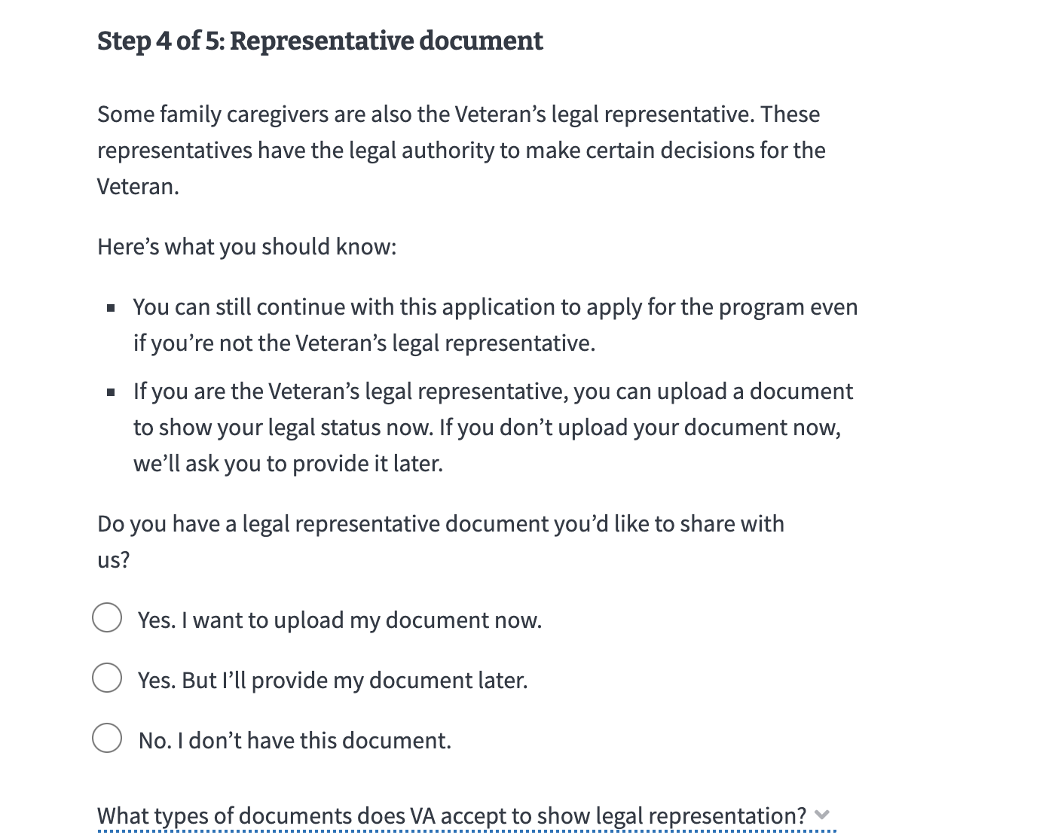
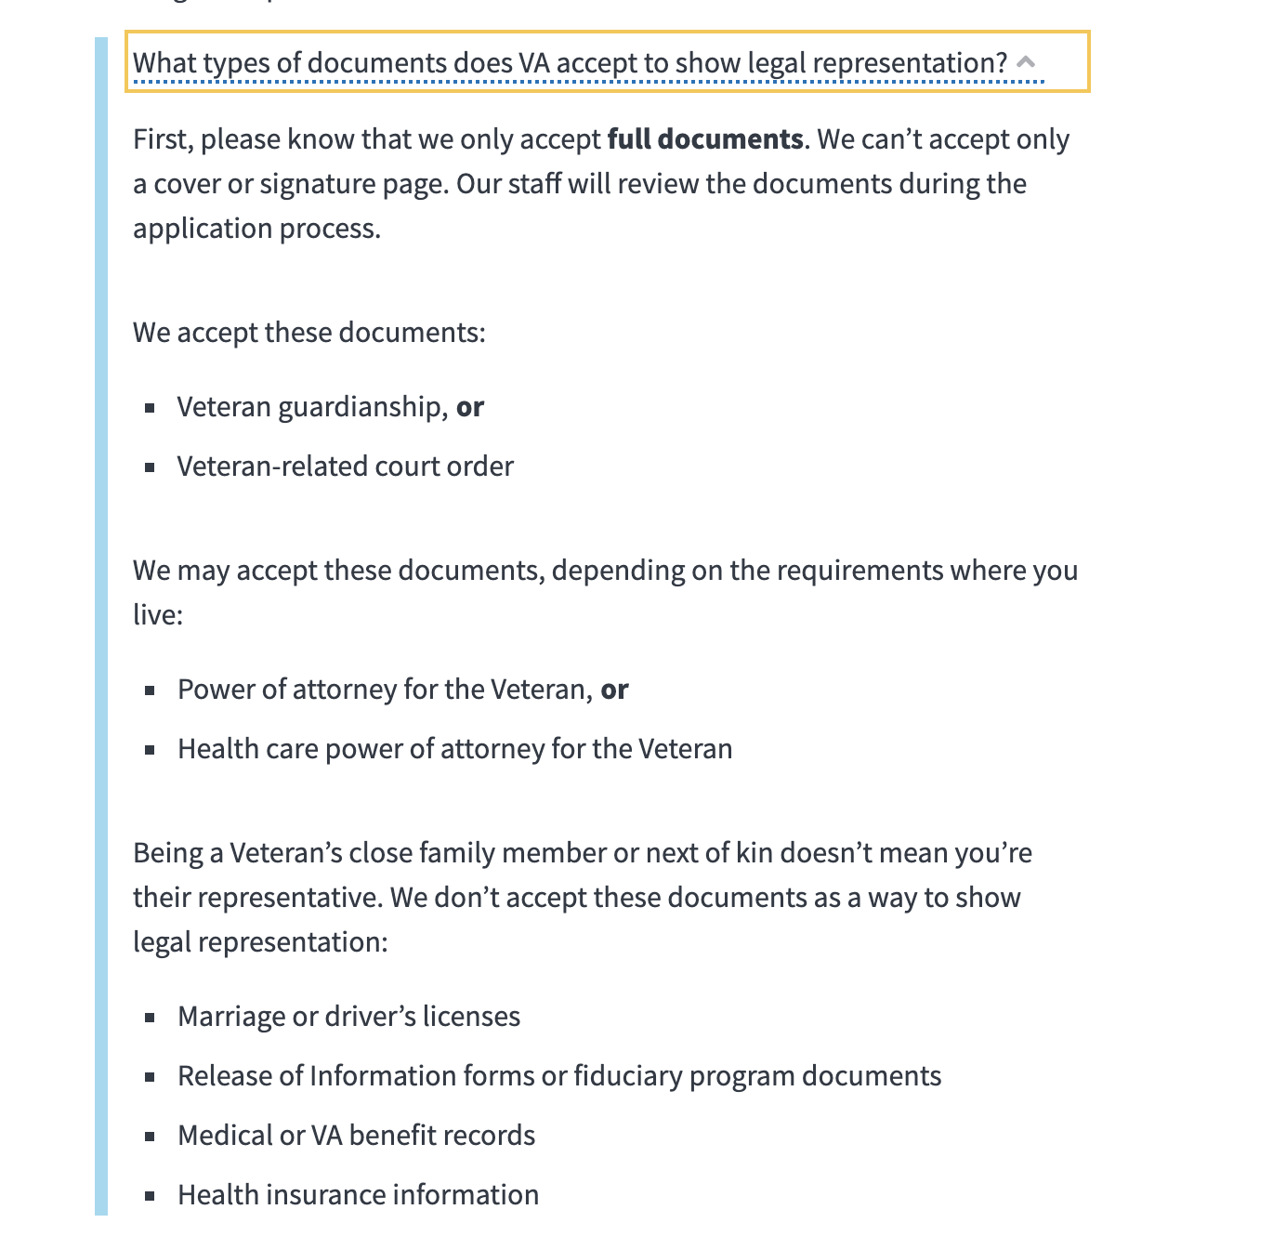
Background
Currently 50% of 10-10CG applicants have the option to upload a document to prove legal representative status.

Slide 6
Background
~35% of uploaded documents can be accepted and provide the necessary legal proof for a representative to sign on behalf of the Veteran. This causes pain points for both the staff in the field and for applicants.
Pain point for Caregiver team in the field that must process the applications, contact each applicant who uploads the wrong document, and possibly work through a new application with them
Pain point for applicants as it could delay their application and create redundant work AKA filling out a whole new application

Slide 7
Perspectives

Slide 8
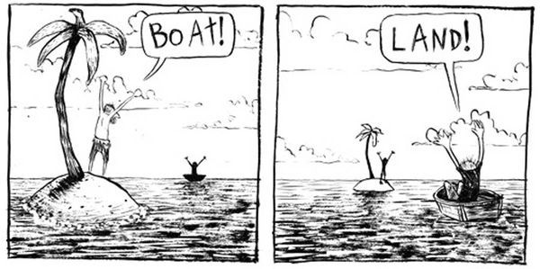

Slide 10
Perspectives-Program team
Perspective
  Uploads that can’t be accepted puts a huge burden on the people who process applications
  We can’t provide specific document names or links because this varies state to state
  It’s a long process to become a “legal” representative so this isn’t something that can be prepared during the application
Solution
  Be more clear about what documents can’t be accepted
  Warn people that wrong submissions could cause an application delay/rejection multiple times

Slide 11
Perspectives-UX & content
Perspectives
  Content is too long/hidden in a more information component. Applicants don’t know what type of document they should upload
  Applicants don’t know the purpose for uploading the document (to sign as a representative)/they think that uploading any document will help support their application
  We don’t want applicants to think that having a legal rep document is a requirement for the program/ create a blocker
Solution
  We can have applicants select document type from a list
  We can directly link the document upload with the signature

Slide 12
Perspectives-Research participants
Perspectives
  Applicants don’t know what type of document they should upload
  Applicants think that the legal rep form is a VA form
  Applicants don’t know the purpose for uploading the document/they think that uploading any document will help support their application
Solution
  Tell us the exact name of document we need to upload/provide a link to the form

Slide 13
How do we get to a shared understanding?

Slide 14
How do we get to a shared understanding?
Working session with the program team
Discovered that the Veteran needs to be deemed unable to make medical decisions for themself

Slide 15
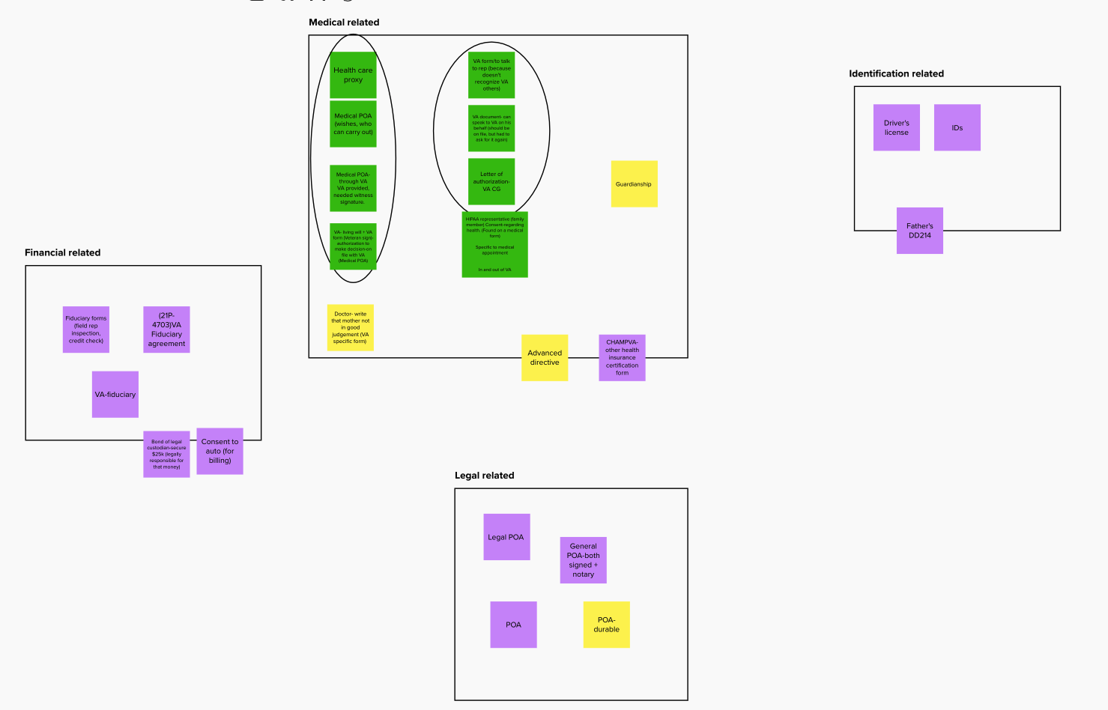
How do we get to a shared understanding?
Mental model- content comprehension study with Caregivers
See more:
Mural research template
Mural synthesis

Slide 16
Mental model- content comprehension study with Caregivers
Participants think about legal representative documentation based on what it enables them to do (eg. make medical decisions) rather than the form name itself.
People think in the categories of: legal, financial, and medical.
The reason that some people upload their driver's license is because they believe that they already have the relevant paperwork on file with VA
Often the ability for the Veteran to sign for themself and make medical decisions/or not depends on the day.
Participants feel like the copy that states that there could be a delay/rejection due to wrong document upload is very negative.

Slide 17
Moving into Bet A

Slide 18
Bet A
Balancing the ideal with time urgency
We recognized that with endless time we could create a completely different flow where different user types could be recognized early in the application and have a “choose your own adventure” experience.
But this would take a lot of time, and the current situation is causing to much of a burden for both the applicants and the processing team

Slide 19
Bet A
Balancing the ideal with time
So “Bet A” was formed
Keep the same flow
Implement as many learnings as possible from the working session and mental model study
Run usability research
Implement iteratively if necessary

Slide 20
Bet A
But what does it look like?
UXPin Prototype (used for usability research)

Slide 21
Bet A
Usability research with Caregivers and Veterans -Key Findings
All participants moved through the "who will sign" selection without friction, and didn't indicate a likelihood of abandonment.
The majority of participants demonstrated an awareness that the requirement of a "medical" stipulation specifically would be necessary to prove that a representative has legal authority to sign on behalf of the Veteran.
All participants recognized that the "who will sign" selection has direct relationship to the signature of the application.
Some participants thought it would help them make a selection if the types of documents accepted/ not accepted were listed on the "who will sign" selection page.
The updated copy that appears after the document upload is well-received. Participants didn't indicate any negative feelings, but rather appreciated the reminder.

Slide 22
Bet A
Next steps
Adjust the intro so that it is also reflective of our research and sets proper expectations for someone signing as a representative
Include the list of can/can’t accepted documents on the who will sign selection page
Make small adjustments for technical constraints of the form system

Slide 23
Bet A
Next steps
Implement at 50%
Monitor document submissions for 1 month to see if we improve the 35% acceptance rate
Monitor analytics for increase in drop-off rate

Slide 24
Other Resources

Slide 25
Other Resources
10-10CG Staging link
Mental model and Content-specific comprehension study (November 2021)
  Research plan
  Conversation guide
  Research: Findings (Github) and Readout presentation
“Bet A” Usability Research (January 2022)
  Research plan
  Conversation guide
  Research: Findings (Github)

